Slide 1

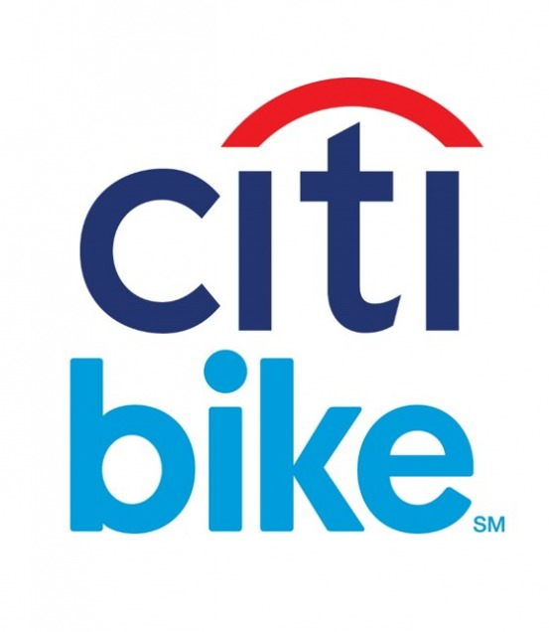
Citi Bike Data Science In New York City Minjae Lee 12/29/2020

Slide 2
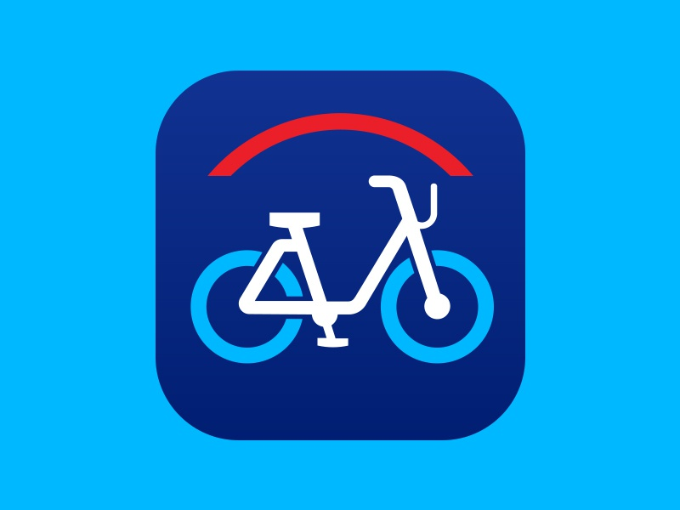
Citi Bike Operation
Bike/Scooter sharing is a new p2p consumer business model
Dockstation version in US
12000 citibikes, more than 750 dock stations in NYC
Operated by motivate, gains monopoly to operate shared-bikes in NYC
1. Individual → Subscriber, Customer
2. Corporate

Slide 3
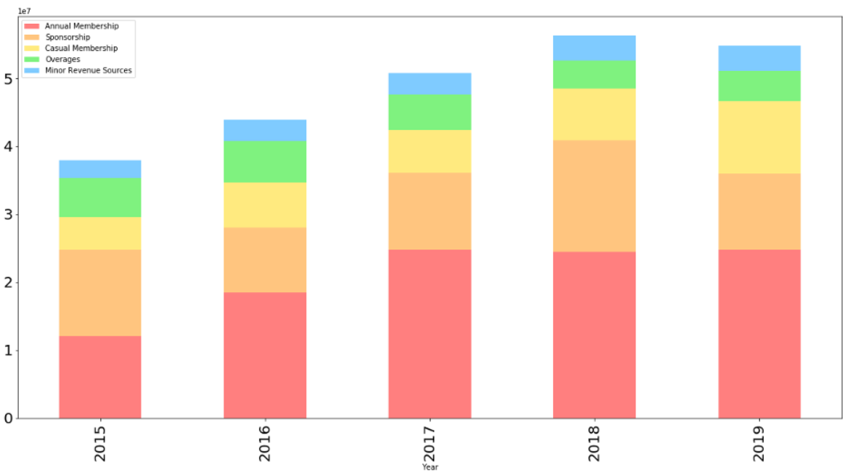
Purpose
The growth of Citi Bike is stagnant due to many sharing competitors. To find out which factors are most important and affect the increase in Subscribers, the most important factor for business growth, and to provide alternatives.

Slide 4
Data
Citi Bike Monthly Trip Data
- Trip data including trip duration, Bike ID,
start and end time, start and end locations,
user type, gender, age
- 5% of each month data
Period of Data
- January 2019 ~ December 2019
Data
- 1,027,583 data and 15 features

Slide 5
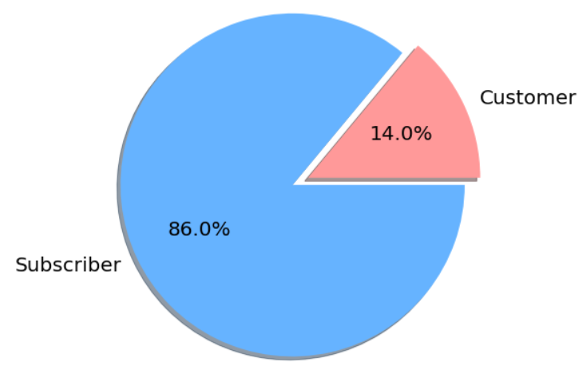
User Type Distribution

Slide 6
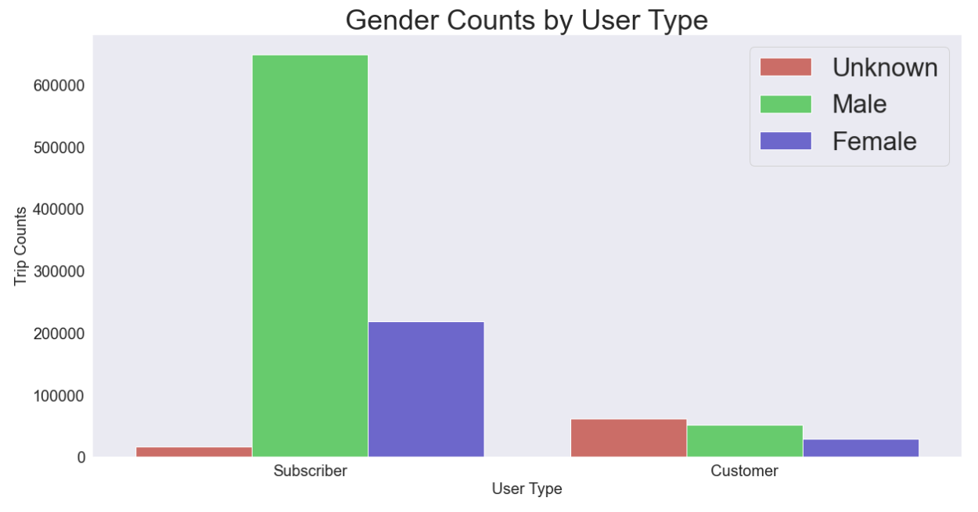
Gender Counts by
User Type
- Customer is almost the same
- In Subscriber, Male is about three times more than Female.

Slide 7
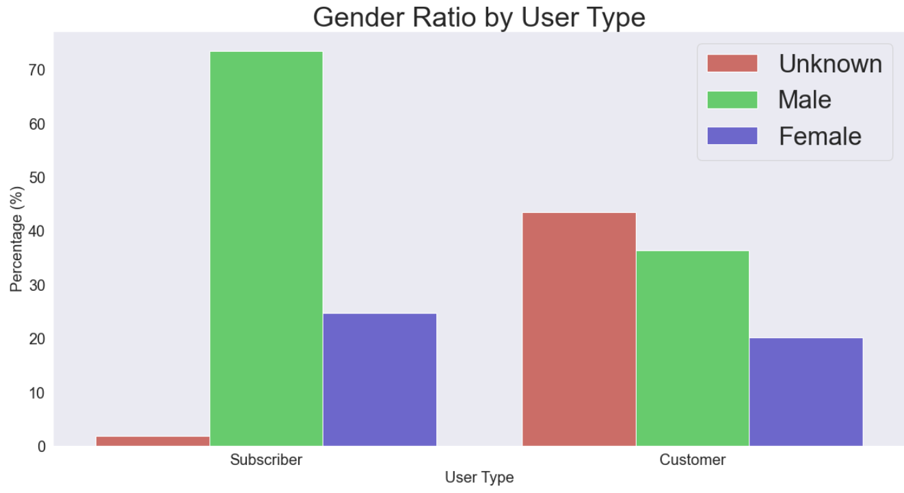
Gender Ratio by
User Type

Slide 8
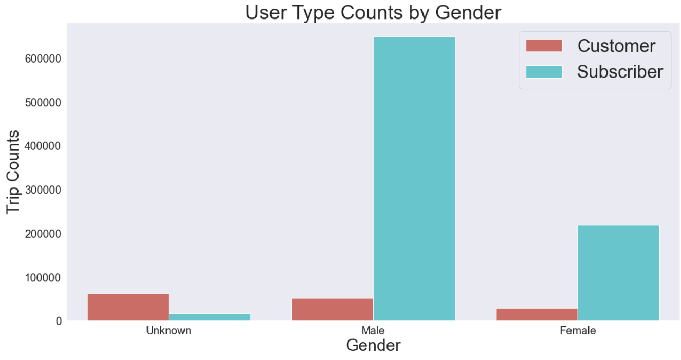
User Type Counts by
Gender

Slide 9
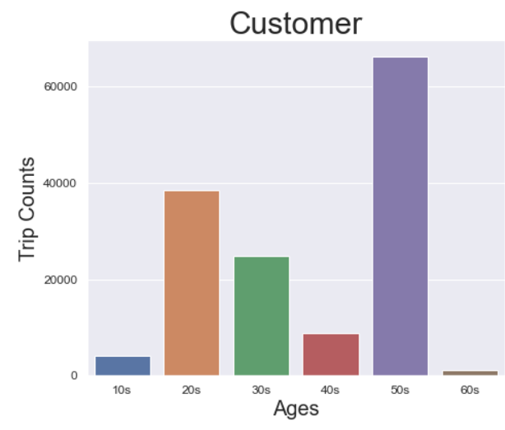
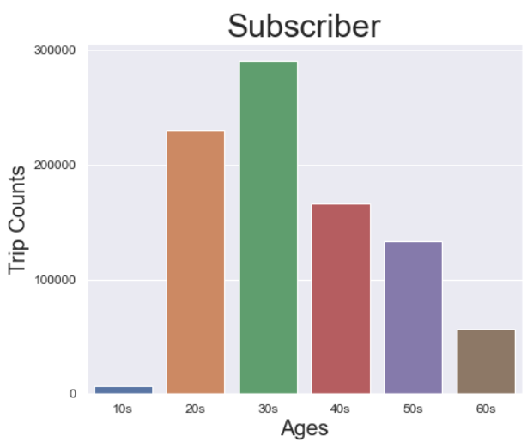
Age Distribution by
User Type

Slide 10
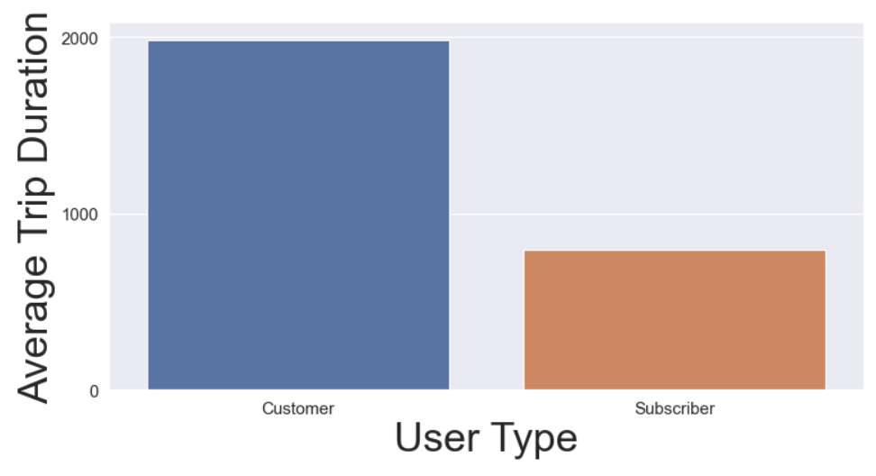
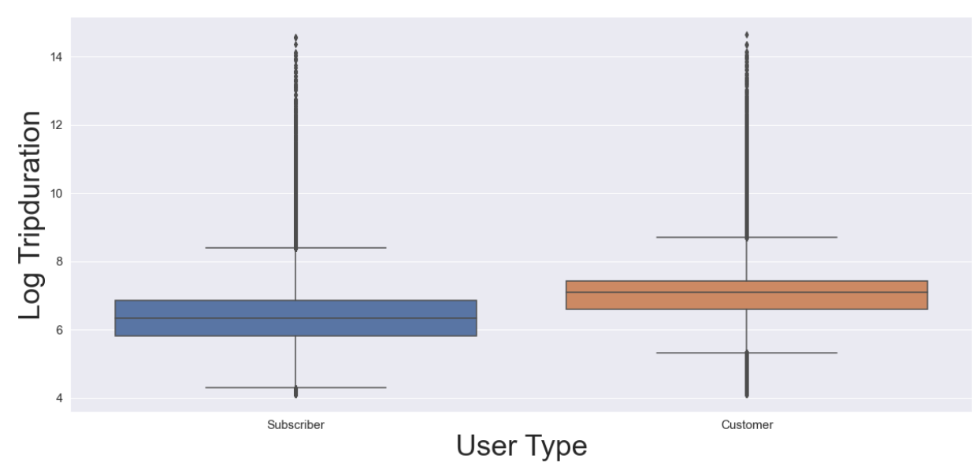
Trip Duration by
User Type

Slide 11
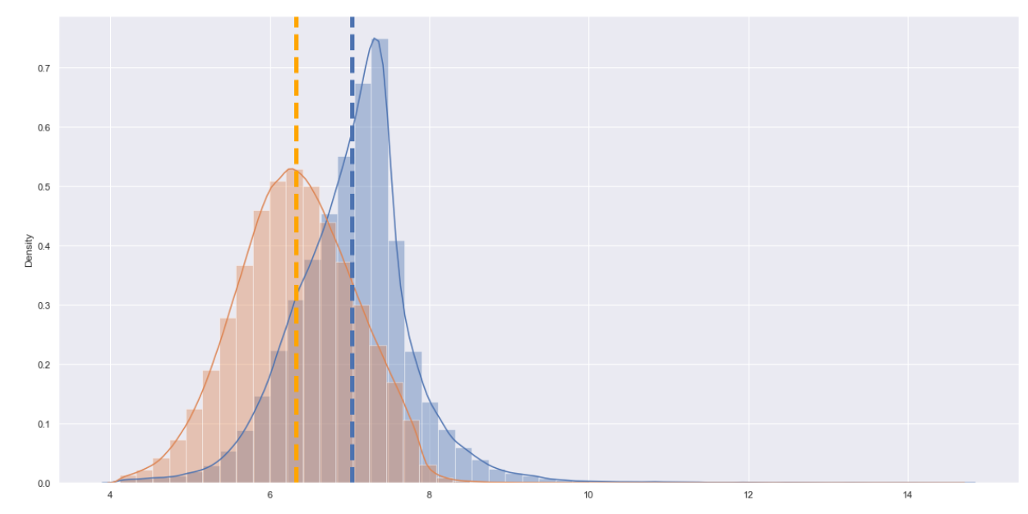

Trip Duration by
User Type

Slide 12
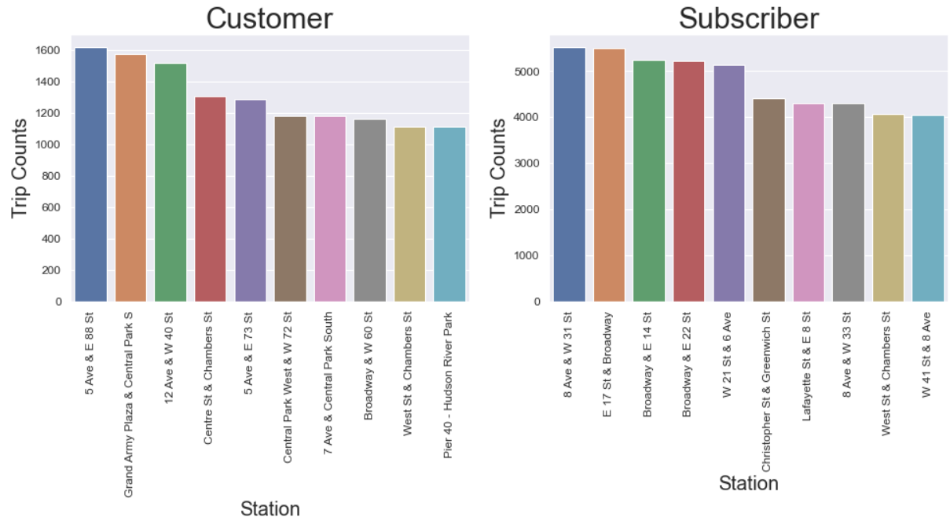
Most Popular Start Stations by User Type

Slide 13
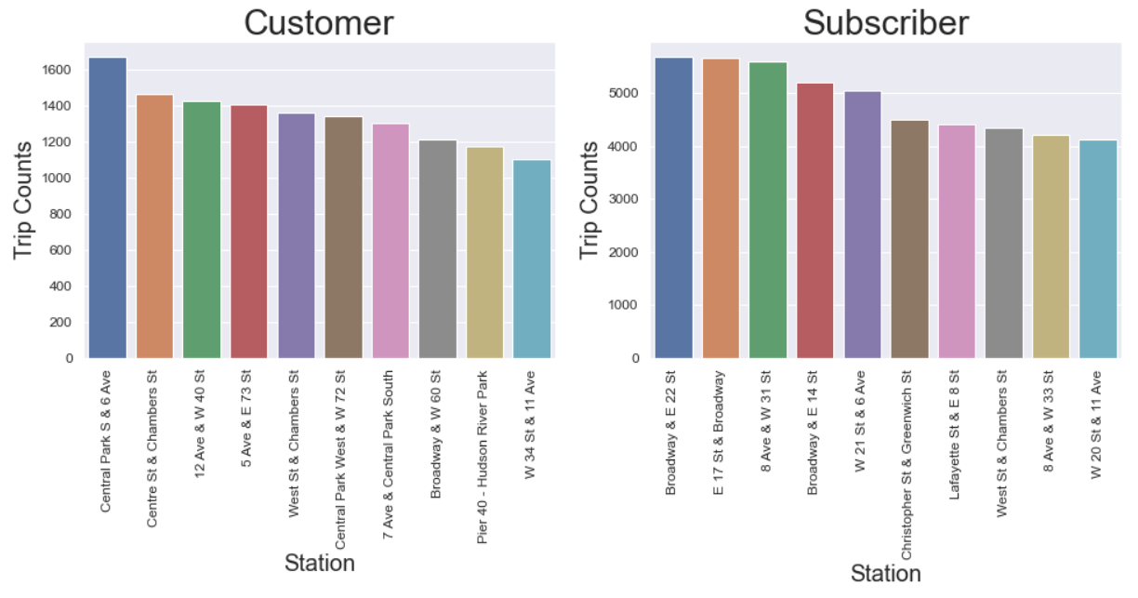
Most Popular Start Stations by User Type

Slide 14
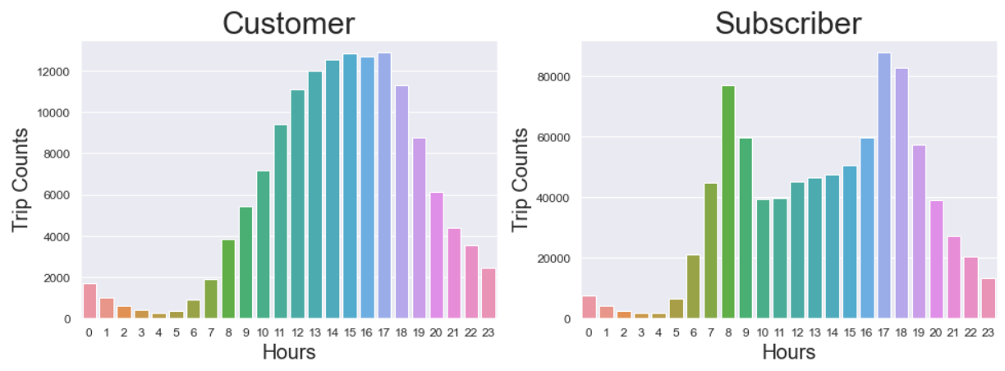
Most Popular Hours by User Type

Slide 15
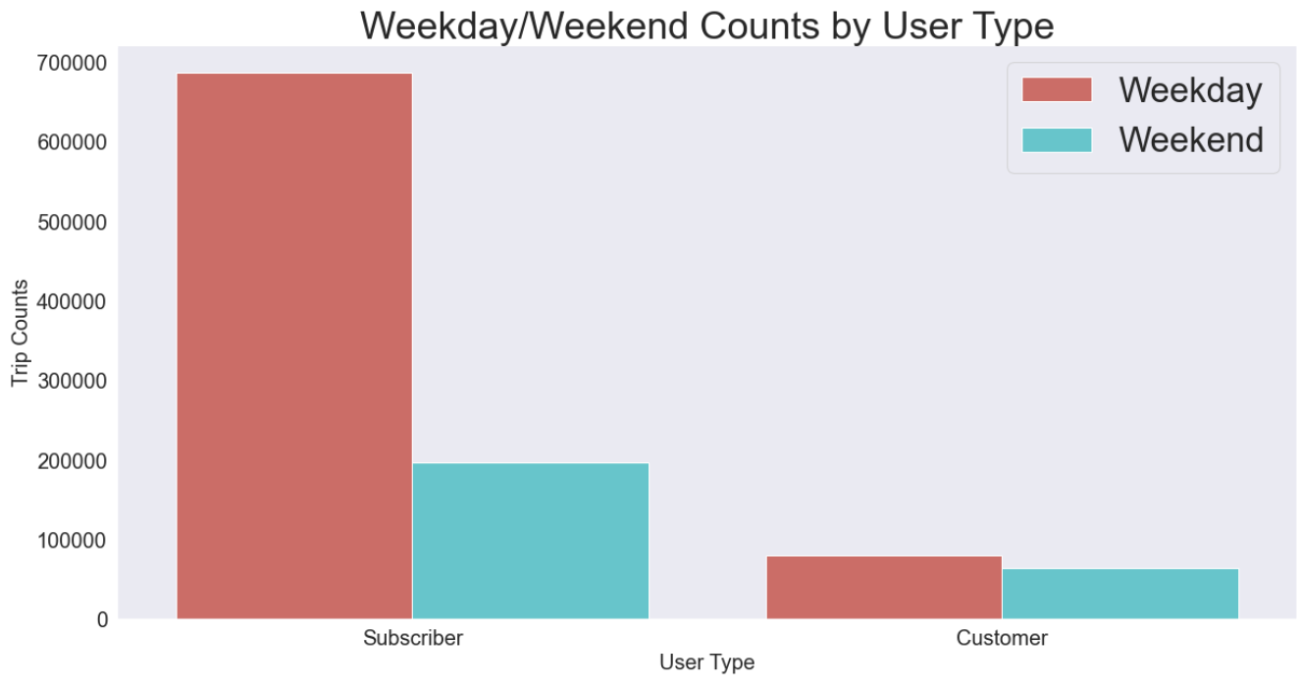

Slide 16
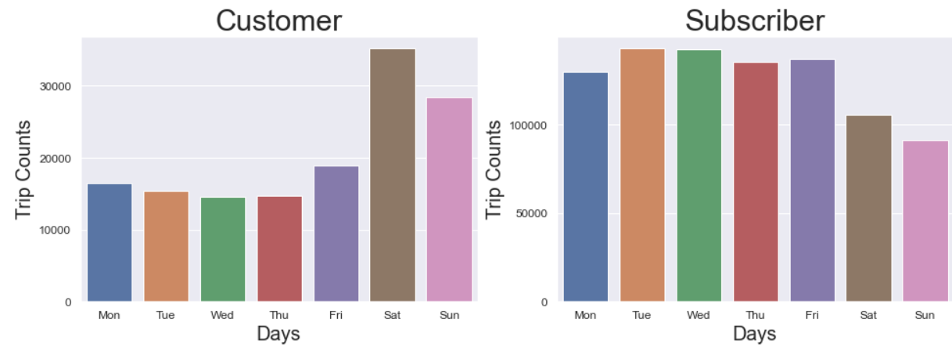
Most Popular Days of by User Type

Slide 17
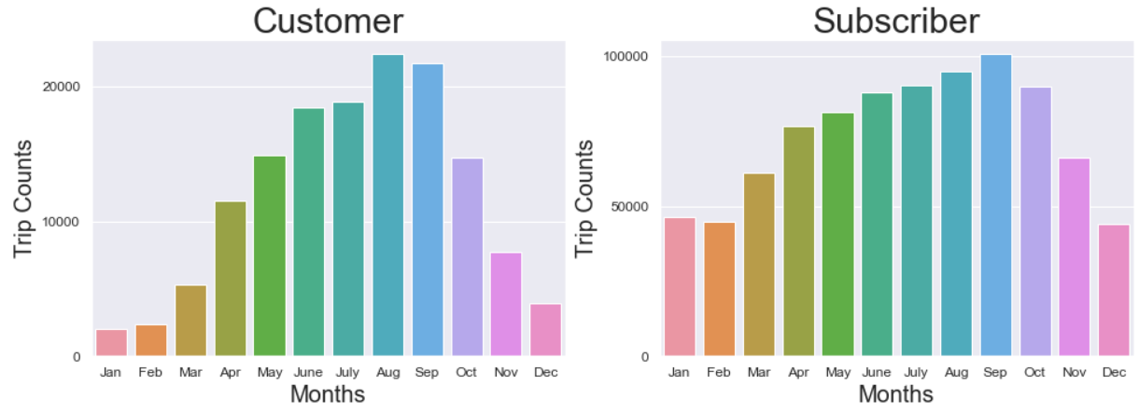
Most Popular Months by User Type

Slide 18
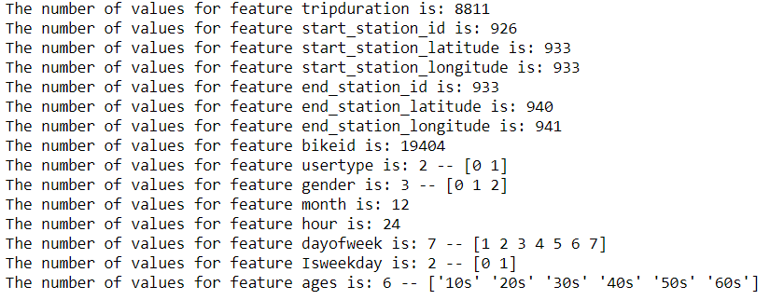
Using Logistic Regression
1,027,583 data and 15 features
Target Variable: User Type
- Subscriber: 0, Customer: 1
All features
Machine
Learning

Slide 19
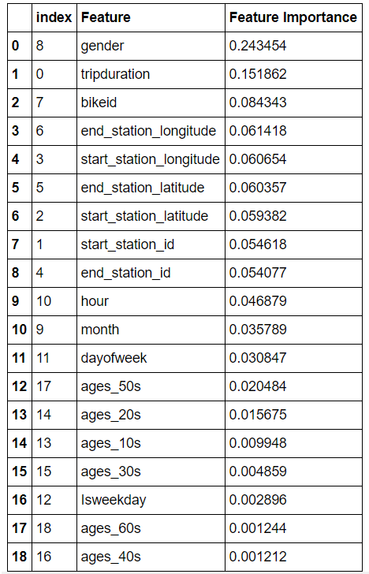
Machine
Learning

Slide 20
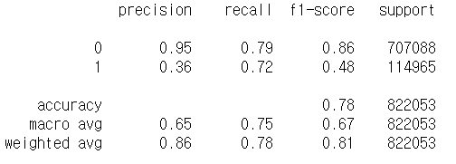
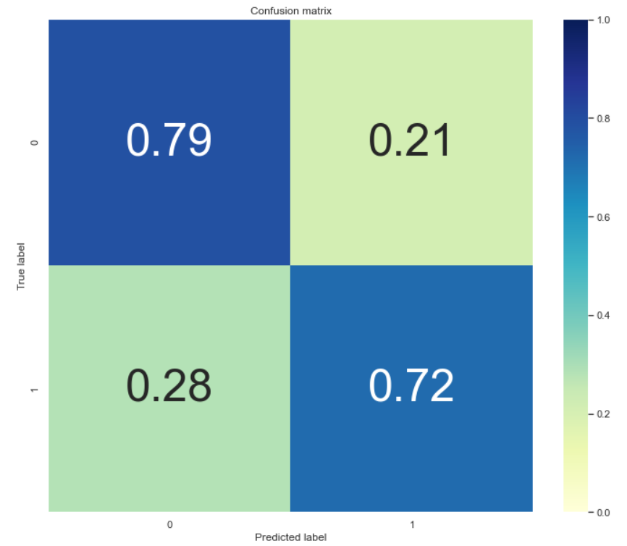
Confusion
Matrix

Slide 21
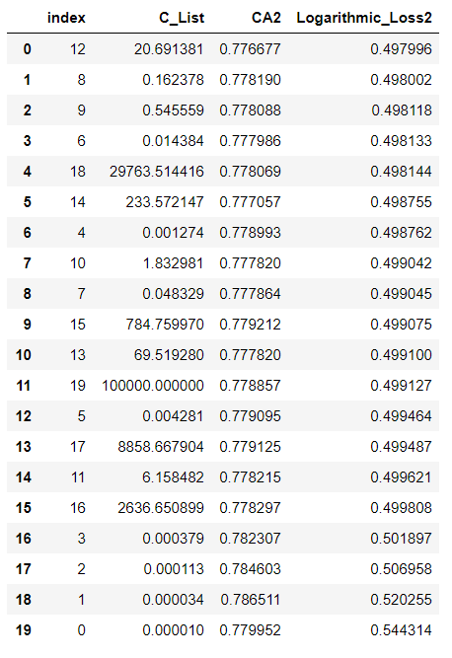
First score:
- Test Accuracy: 0.77776
Dummy Classifier:
- Test Accuracy: 0.85997
Grid Search:
- Test Accuracy: 0.86135
Final Score (Log Loss):
- Test Accuracy: 0.86564
Machine
Learning

Slide 22
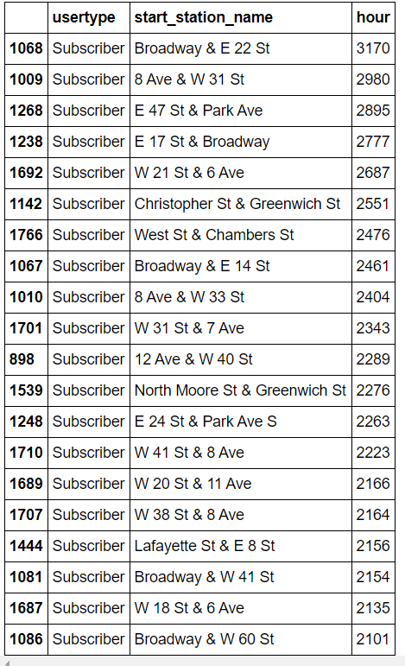
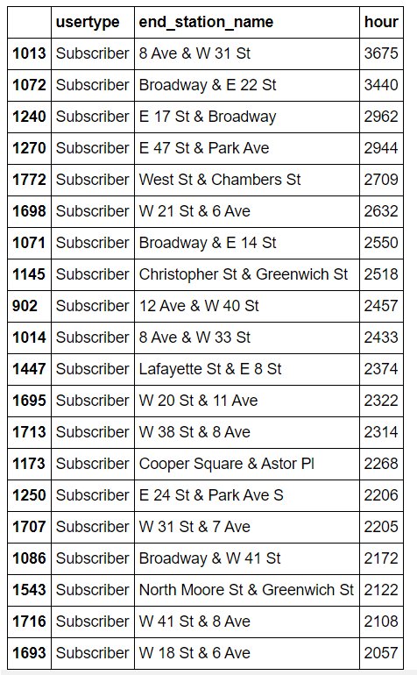
Most Popular Start, End Stations by Subscribers in Rush Hours
[7, 8, 9, 16, 17, 18, 19]
Near Penn Station or Grand Central
Many subscribers take a LIRR, train and then use CitiBike
Advantage or discount Citi Bike fare to LIRR, train passengers

